Slide 1
Name:-Hase Sarika Dnyandeo Enrollment No:-EBEON1221505537 Batch:-6520 Subject:-Student management System

Slide 2
Student Management System
Under Guidance of technical trainer,
Chittaranjan Gosh Sir.
Batch :- 6520
Center:- Pune(Pimpari Chinchwad)

Slide 3
INTRODUCTION
Student Management System can handle all the details about a student.The details ,student personal details,Academic details etc.
The student management system is an automated version of manual student management System

Slide 4
Tools And Platform
We have used MySql database and java for making this project.
For saving the data of student we have used mysql database.
The entire project executes on the eclipcse ide server.

Slide 5
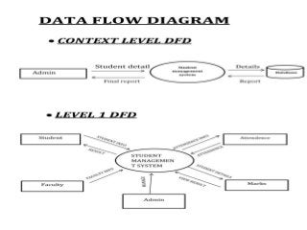

Slide 6
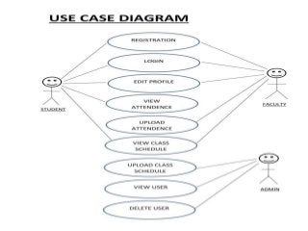

Slide 7
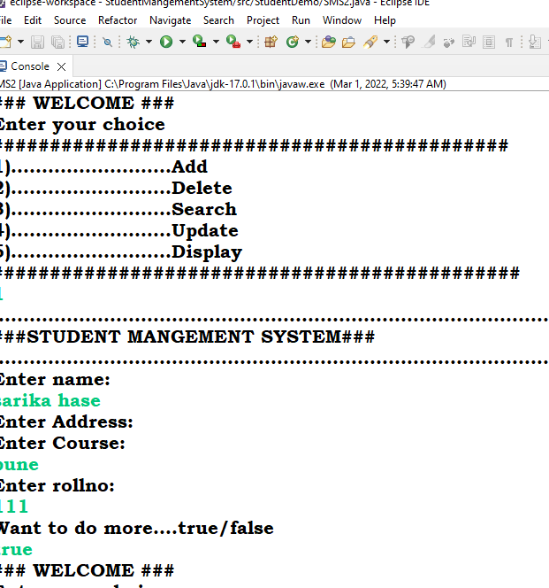
Screenshort:-

Slide 8
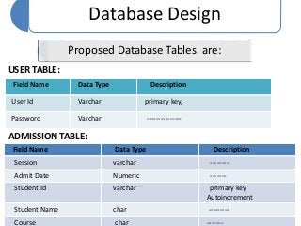
Database Design:-

Slide 9
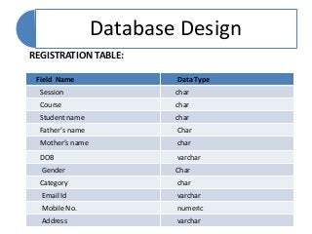

Slide 10
Future Scope of the Project
In the Future student can also be able to upload or download notes.
We will see the entire system more interactive and also be able to give statistics data.
We can run the entire system in any operating system and also we have an android application of this entire system.

Slide 11
Thank You……..

